Slide 1

Capstone Project
Book Recommendation System
B By-Shailendra, Umesh, Akram, Ifraz

Slide 2
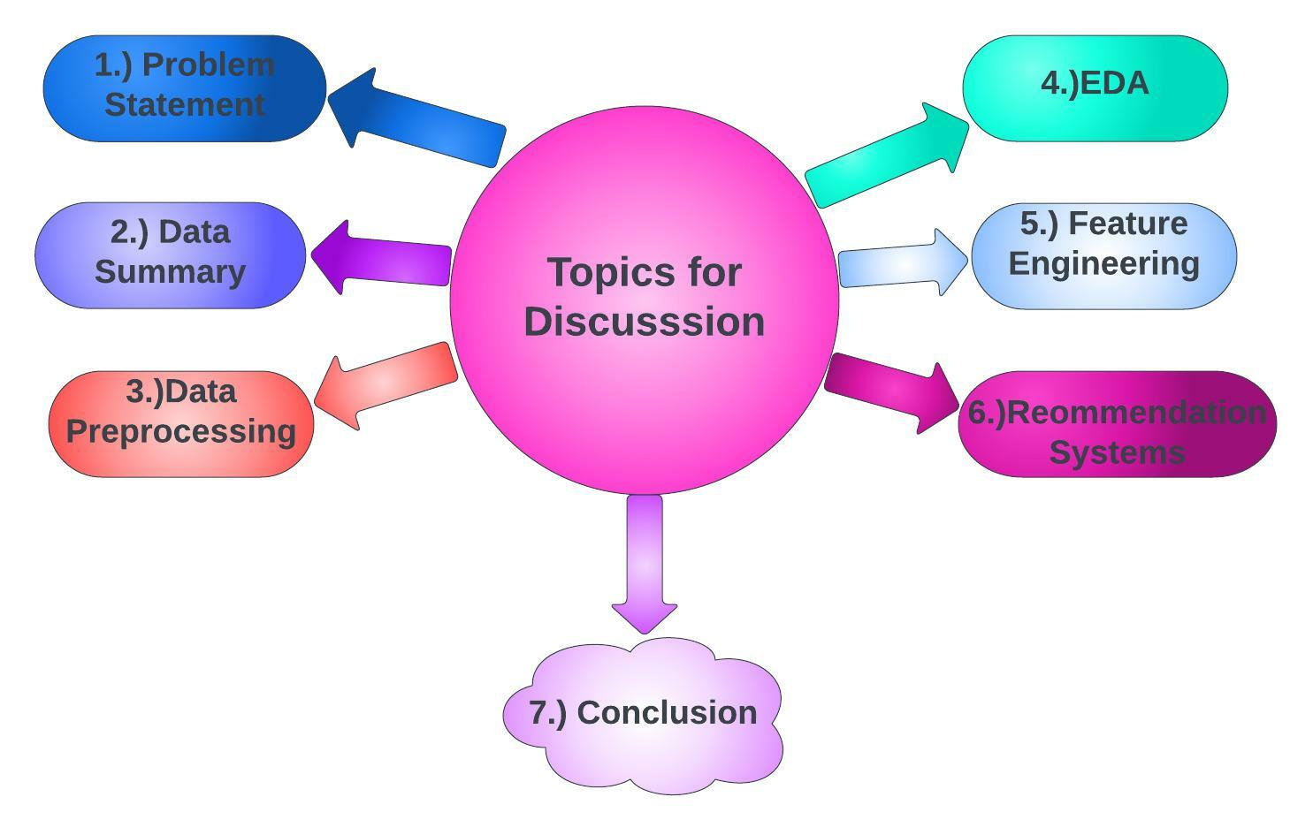
Content

Slide 3
Problem Statement
● During the last few decades, recommender systems have taken more and more place in our lives. From e-commerce to online advertisement, recommender systems are today unavoidable in our daily online journeys.
● Recommender systems are really critical in some industries as they can generate a huge amount of income when they are efficient or also be a way to stand out significantly from competitors.
● Recommender systems are algorithms aimed at suggesting relevant items to users. The main objective is to create a book recommendation system for users.

Slide 4
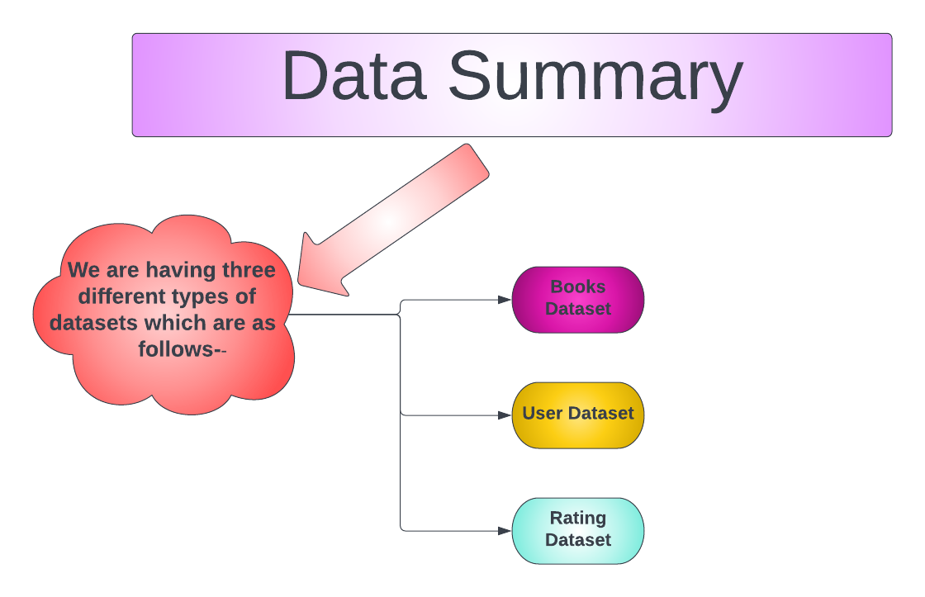

Slide 5
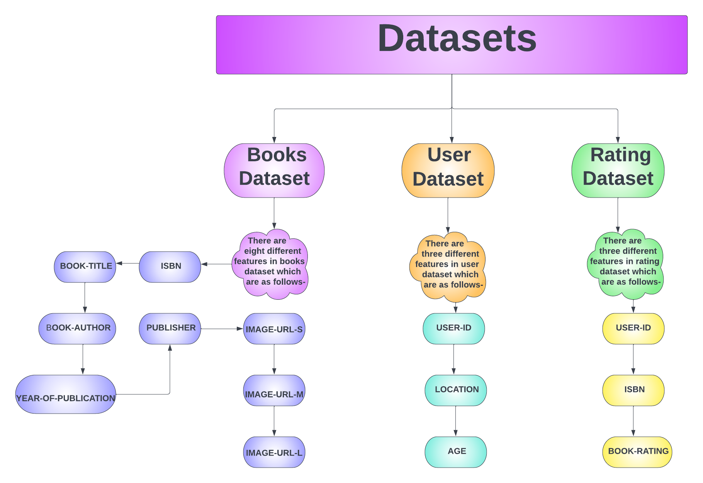

Slide 6
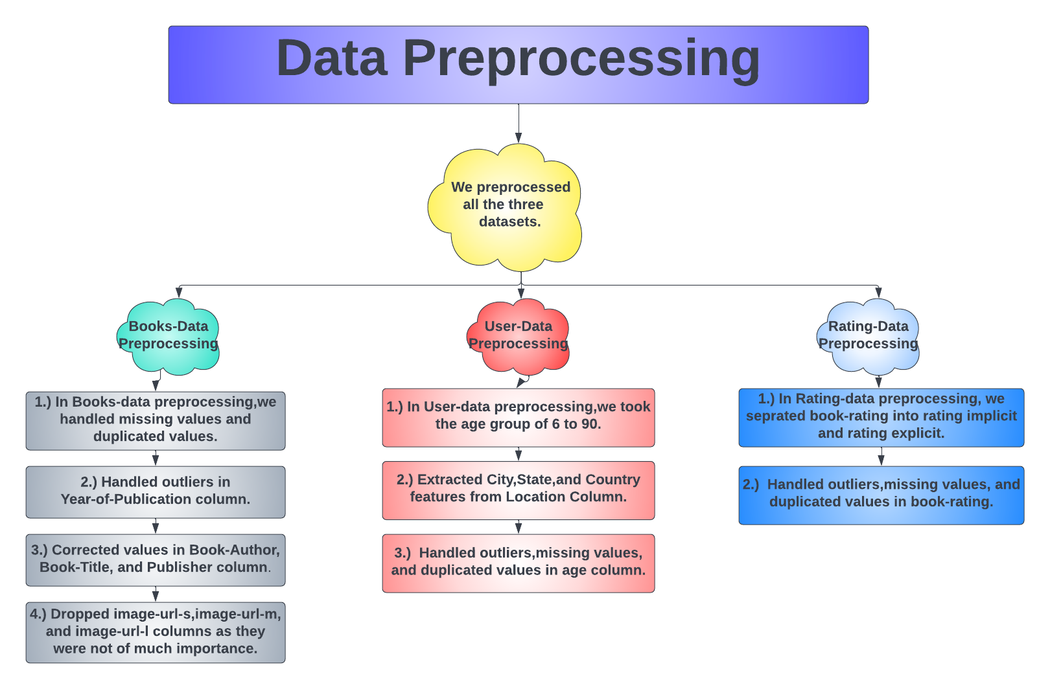

Slide 7
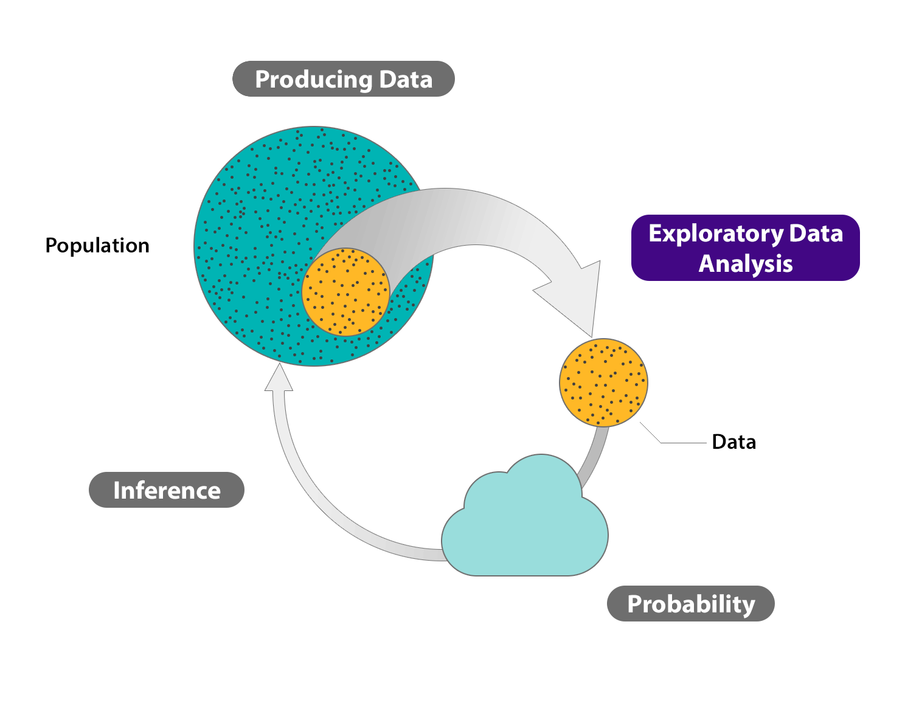

Slide 8
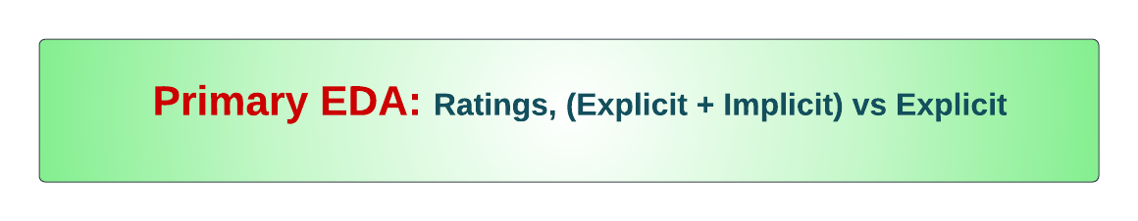
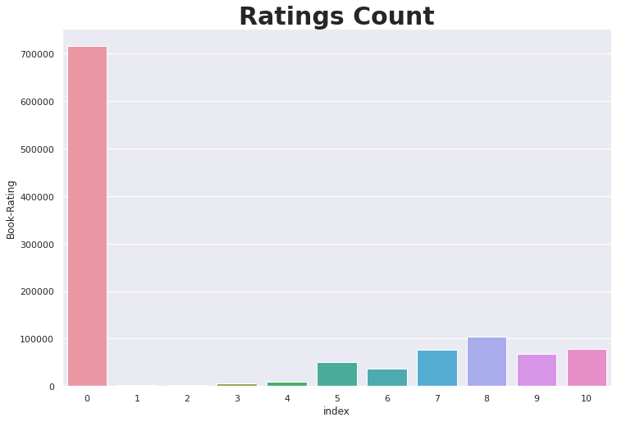
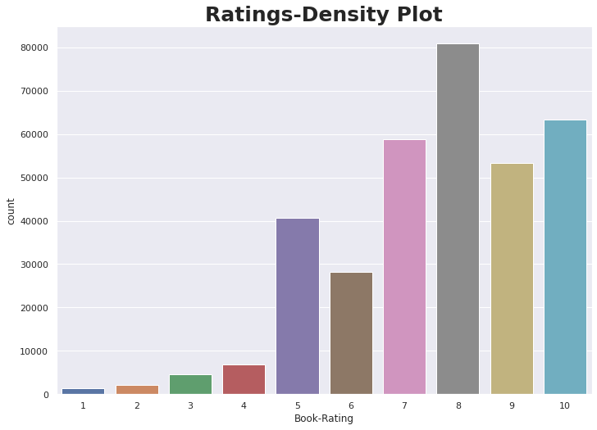

Slide 9
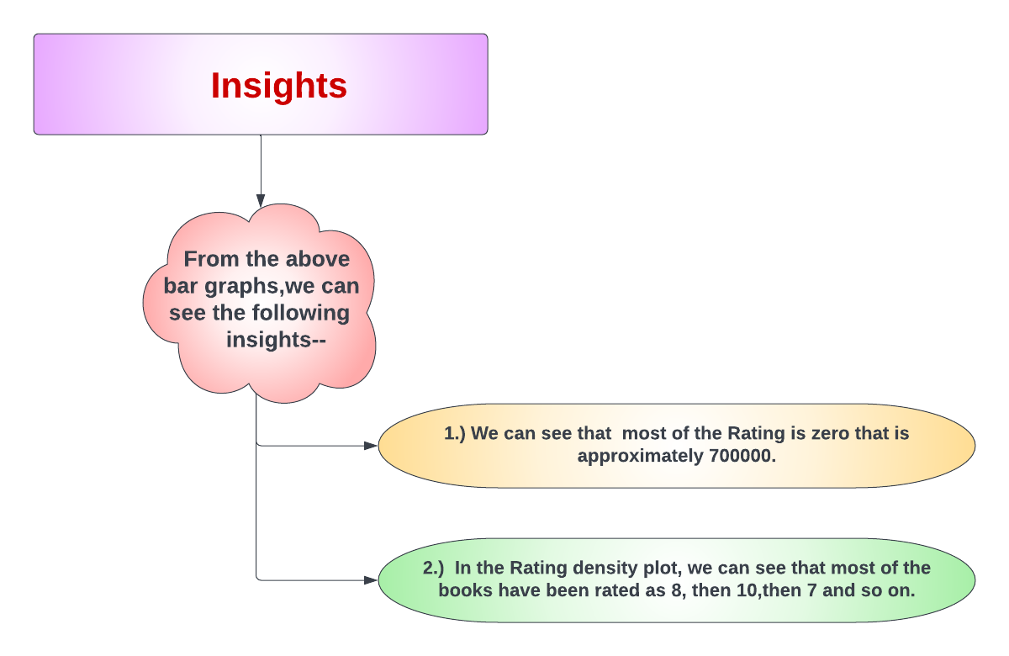

Slide 10

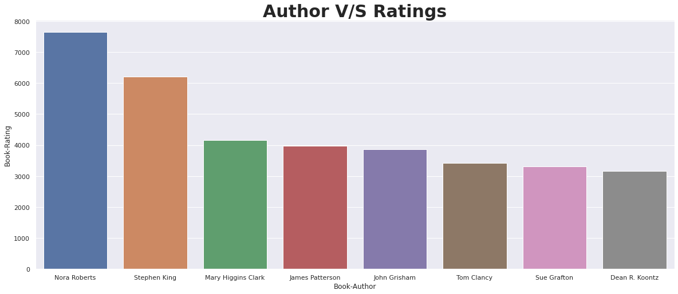
Insights:-
Here, we can observe, most frequently rated Authors.
Most frequently rated author is Nora Roberts, followed by Stephen King

Slide 11
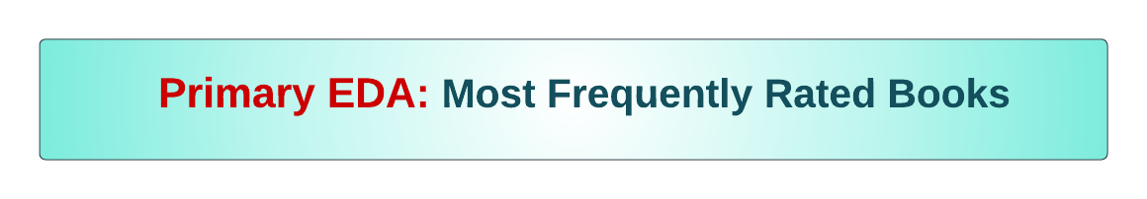
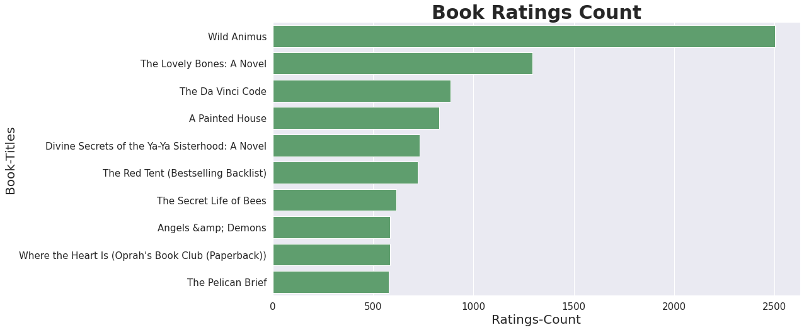
Insights:-
Here, we are able to observe, most frequently rated books by the users.
Most frequently rated book, happens to be “Wild Animus”.

Slide 12
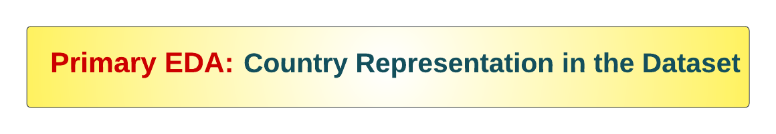
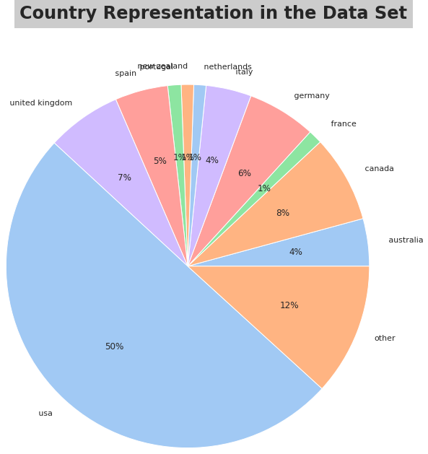
Insights:-
Most customers are from the United States of America, followed by Canada, United Kingdom and Germany.
Countries with less than 1% customers are labelled as other.

Slide 13

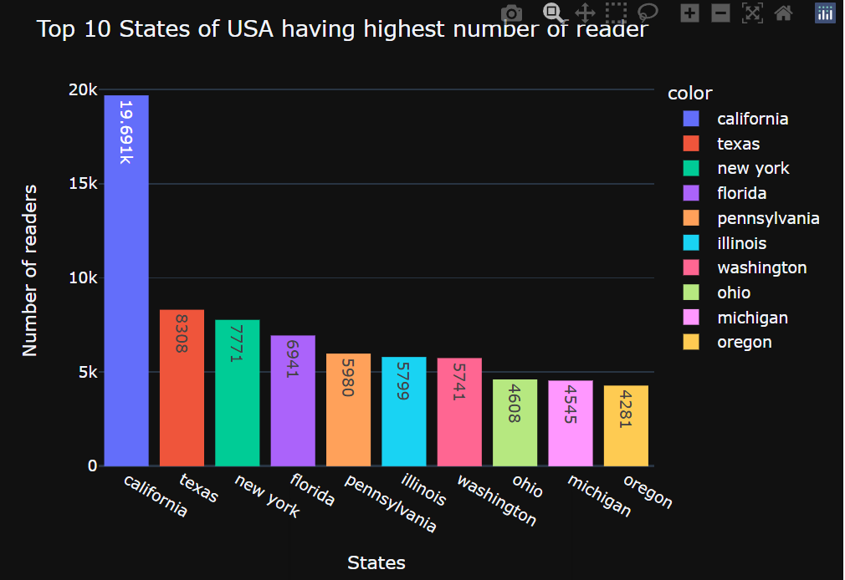
Insights:-
We can see here that “California” State has highest number of readers of 19.691k.
“Texas” is the second state with highest number of user of 8,308.
“Oregon” state has least number of users.

Slide 14

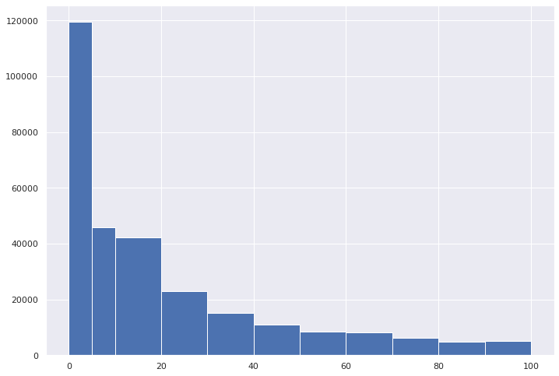
Insights:-
Here, we are able to observe, which age bin has contributed most to the Book-Ratings.

Slide 15

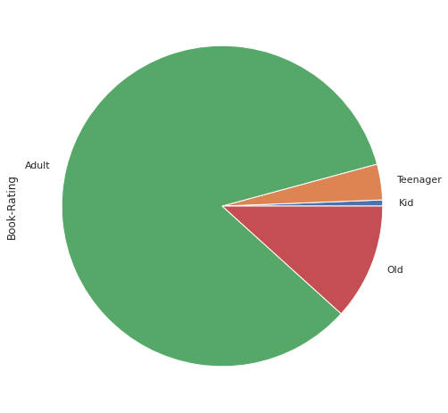
Insights:-
Most customers are Adults (20-50yrs).
2nd most represented age group is for old (>50yrs).

Slide 16

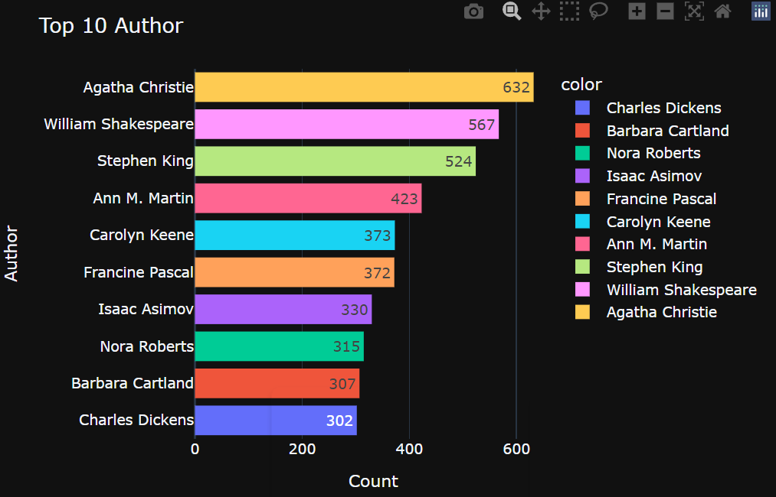
Insights:-
We can see that “Agatha Christie” is the best author who has written 632 books.
“William Shakespeare” is the second best author who has written 567 books.

Slide 17

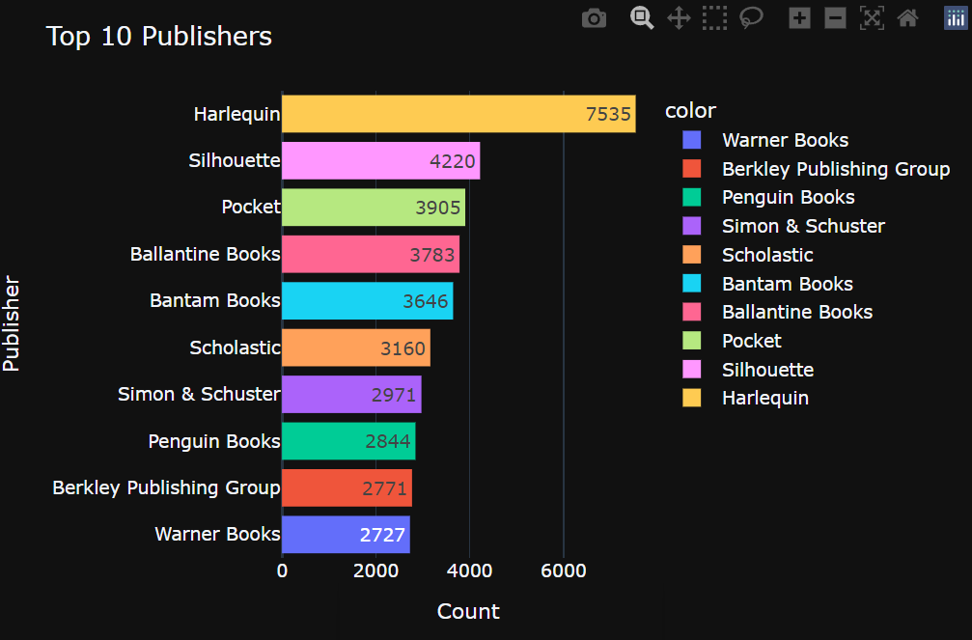
Insights:-
We can see that “Harlequin” is the best publisher which has published 7,535 books.
“Silhouette” is the second best publisher which has published 4,220 books.

Slide 18

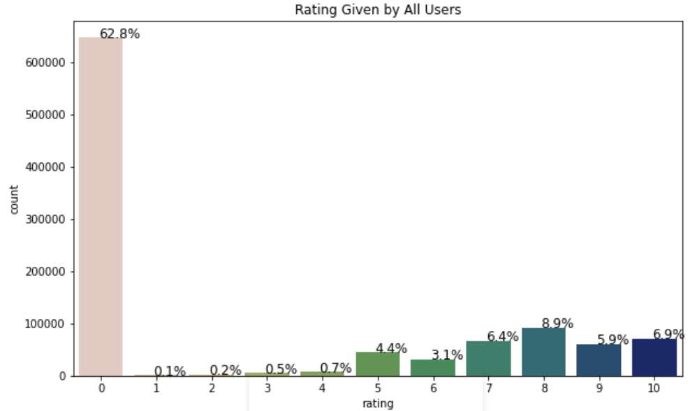
Insights:-
We can see that most of the user has given rating as 0 which is approximately 62.8%.

Slide 19



Slide 20
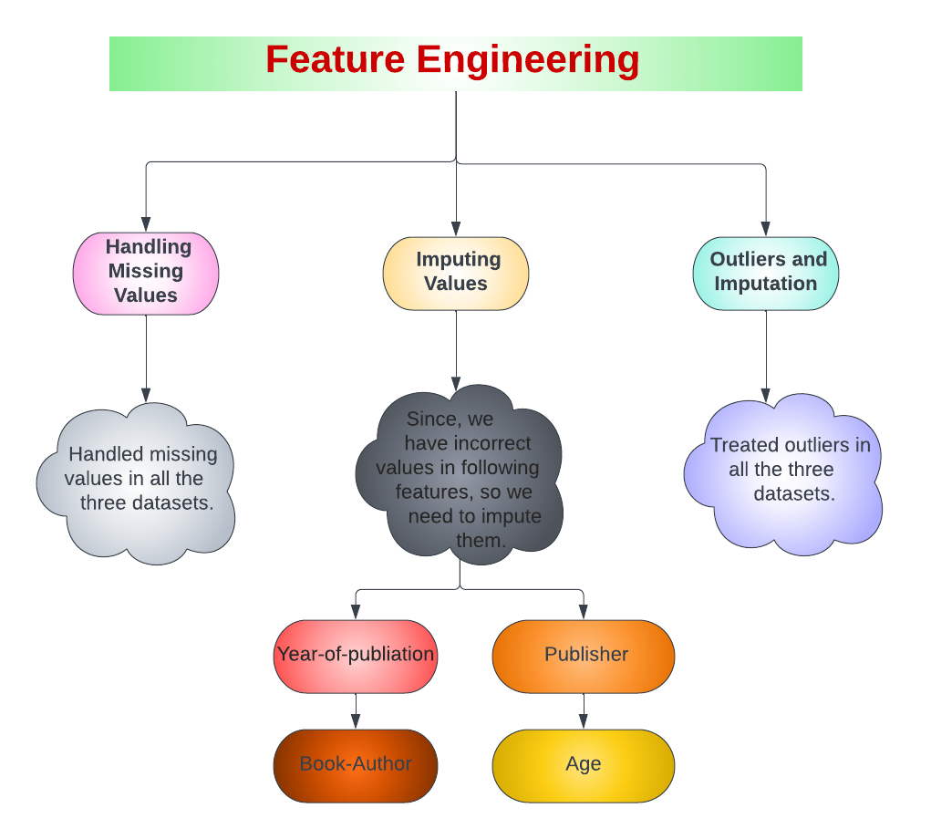

Slide 21


Slide 22
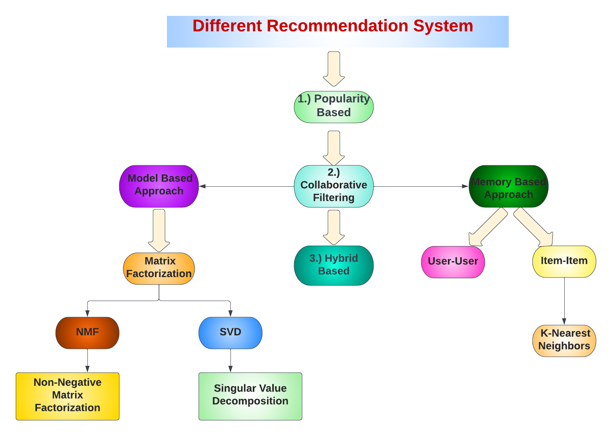

Slide 23
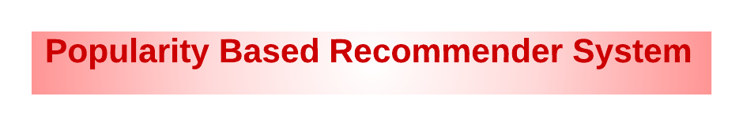
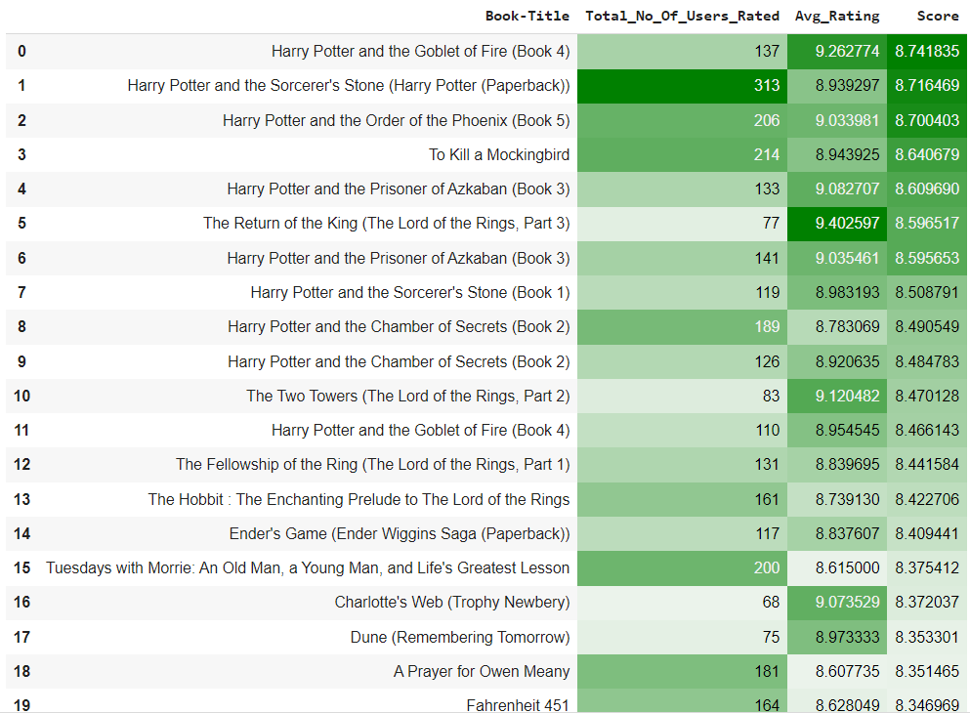
So, we can see that popularity metric we can calculate the top books that could be recommended to a user.

Slide 24


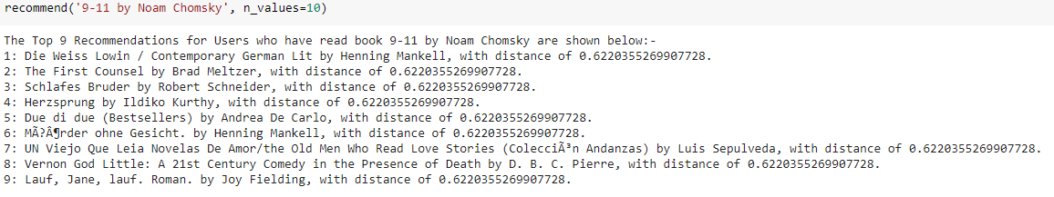
A KNN model, with cosine similarity as a metric for measuring the distance between different ratings, was used to provide recommendations.
Insight:-
We can see, that the recommended books, are quite similar in genre to the selected item

Slide 25

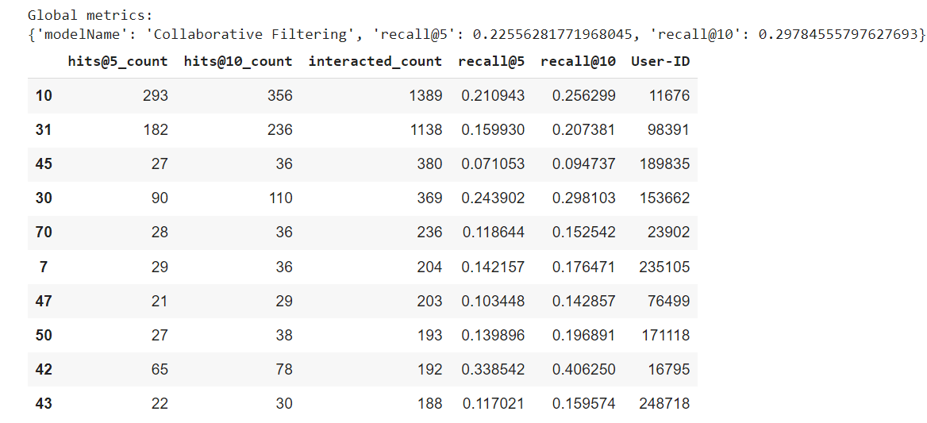
It makes predictions about the interests of a user by collecting preferences from many users. The underlying assumption is, if a person A has the same opinion as a person B on a set of items, A is more likely to have B's opinion for a given item than that of a randomly chosen person.

Slide 26
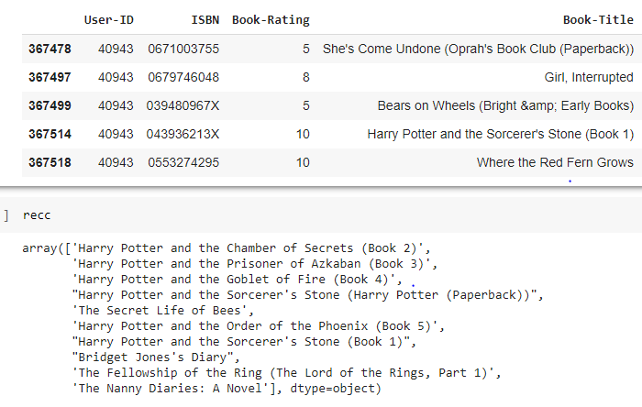
We can see, the user: 40943, has rated Harry Potter and the Sorcerer's Stone (Book 1), very highly. Our model, is recommending other parts of the same series. This seems to be consistent with high precision and high recall values that we have obtained thus far.

Slide 27
Conclusion:-
In EDA, the Top-10 most rated books were essentially novels. Books like The Lovely Bone and The Secret Life of Bees were very well perceived.
Majority of the readers were of the age bracket 20–35 and most of them came from North American and European countries namely USA, Canada, UK, Germany and Spain.
If we look at the ratings distribution, most of the books have high ratings with maximum books being rated 8. Ratings below 5 are few in number.
Author with the most books was Agatha Christie, William Shakespeare and Stephen King.
For modelling, it was observed that for model based collaborative filtering SVD technique worked way better than NMF with lower Mean Absolute Error (MAE) .
Amongst the memory based approach, item-item CF performed better than user-user CF because of lower computation requirements .
It is very important to deal with implicit and explicit user ratings, separately.
For dealing with explicit ratings, we can build simple models based on ratings, and we can also use certain comprehensive models based on Collaborative Filtering approach.
For dealing with implicit ratings, we can build KNN based models , and we can also use content based models, which utilize the similarity of different contents, to make recommendations.
It is crucial to be precise about user preferences, otherwise repetitive recommendations can cause nuisance to the user.

Slide 28

Handling of sparsity was a major challenge as well since the user interactions were not present for the majority of the books.
Understanding the metric for evaluation was a challenge as well.
Since the data consisted of text data, data cleaning was a major challenge in features like Location etc.
Decision making on missing value imputations and outlier treatment was quite challenging as well.

Slide 29


